Slide 1



Quantifying replicability in the human microbiome literature using BugSigDB, a community-editable database of published microbiome methods and results
Levi Waldron
November 14, 2023
Funding: NCI 1R01 CA230551

Slide 2









Student curators
~80 unlisted
Marianthi Thomatos
Utsav Patel
Valentina Pineda
Yaseen Javaid
Lora Kasselman
Philippe Lutete
Aboud Ezzeddine
Afroza Parvin
Victoria Goulbourne
William Lam
Zyaijah Bailey
Lucy Mellor
Mst Afroza Parvin
William Lam
Cynthia Anderson
Phyu Han
Nadine Ulysse
Tahiya Begum
Christina Brown
Aboud Eby
Yu Wang
Joyessa Dey
Frans Cuevas
Martha Marin
Clare Grieve
Kweku Amoo
Samara Khan
Tangirul Islam
Mary Bearkland
Thank you
Kelly Eckenrode, PhD
Chloe Mirzayi, MPH
Rimsha Azhar, MS
Fatima Zohra, MPH
Shaimaa Elsafoury, MPH
Jennifer Wokaty, BA
Collaborators
Nicola Segata, UNITN
Eric Franzosa and Curtis Huttenhower, HSPH
Vincent Carey and Rafael Gonçalves, HMS
Sean Davis, CU
Pratyay Sengupta, IIT
Isaac Hecht, Wikiworks
Aarthi Ravikrishnan, GIS
Jennifer B Dowd, Oxford
Heidi E Jones, CUNY
Marcel Ramos, MPH
Sehyun Oh, PhD
CUNY Student curators
Jacquelyn Shevin
Maryem Zaki
Archana Dwivedi
Ifeanyi Kalu
Jessica Shudy
Sharmila Chunduri
Umadevi J Yokeeswaran
Ludwig Geistlinger, PhD

Slide 3
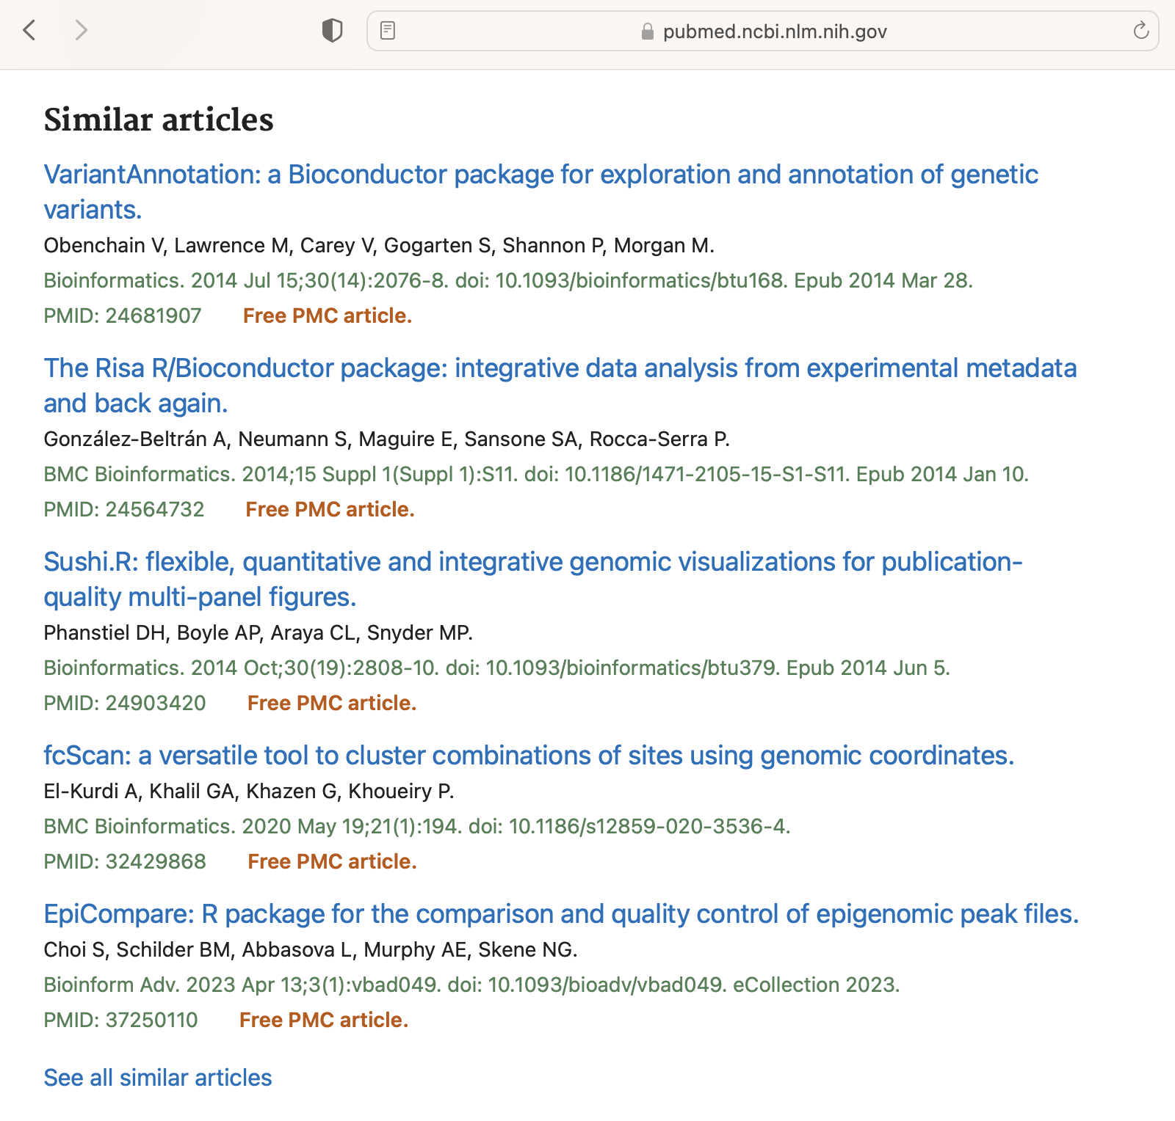

How do we consume scientific literature?

Slide 4
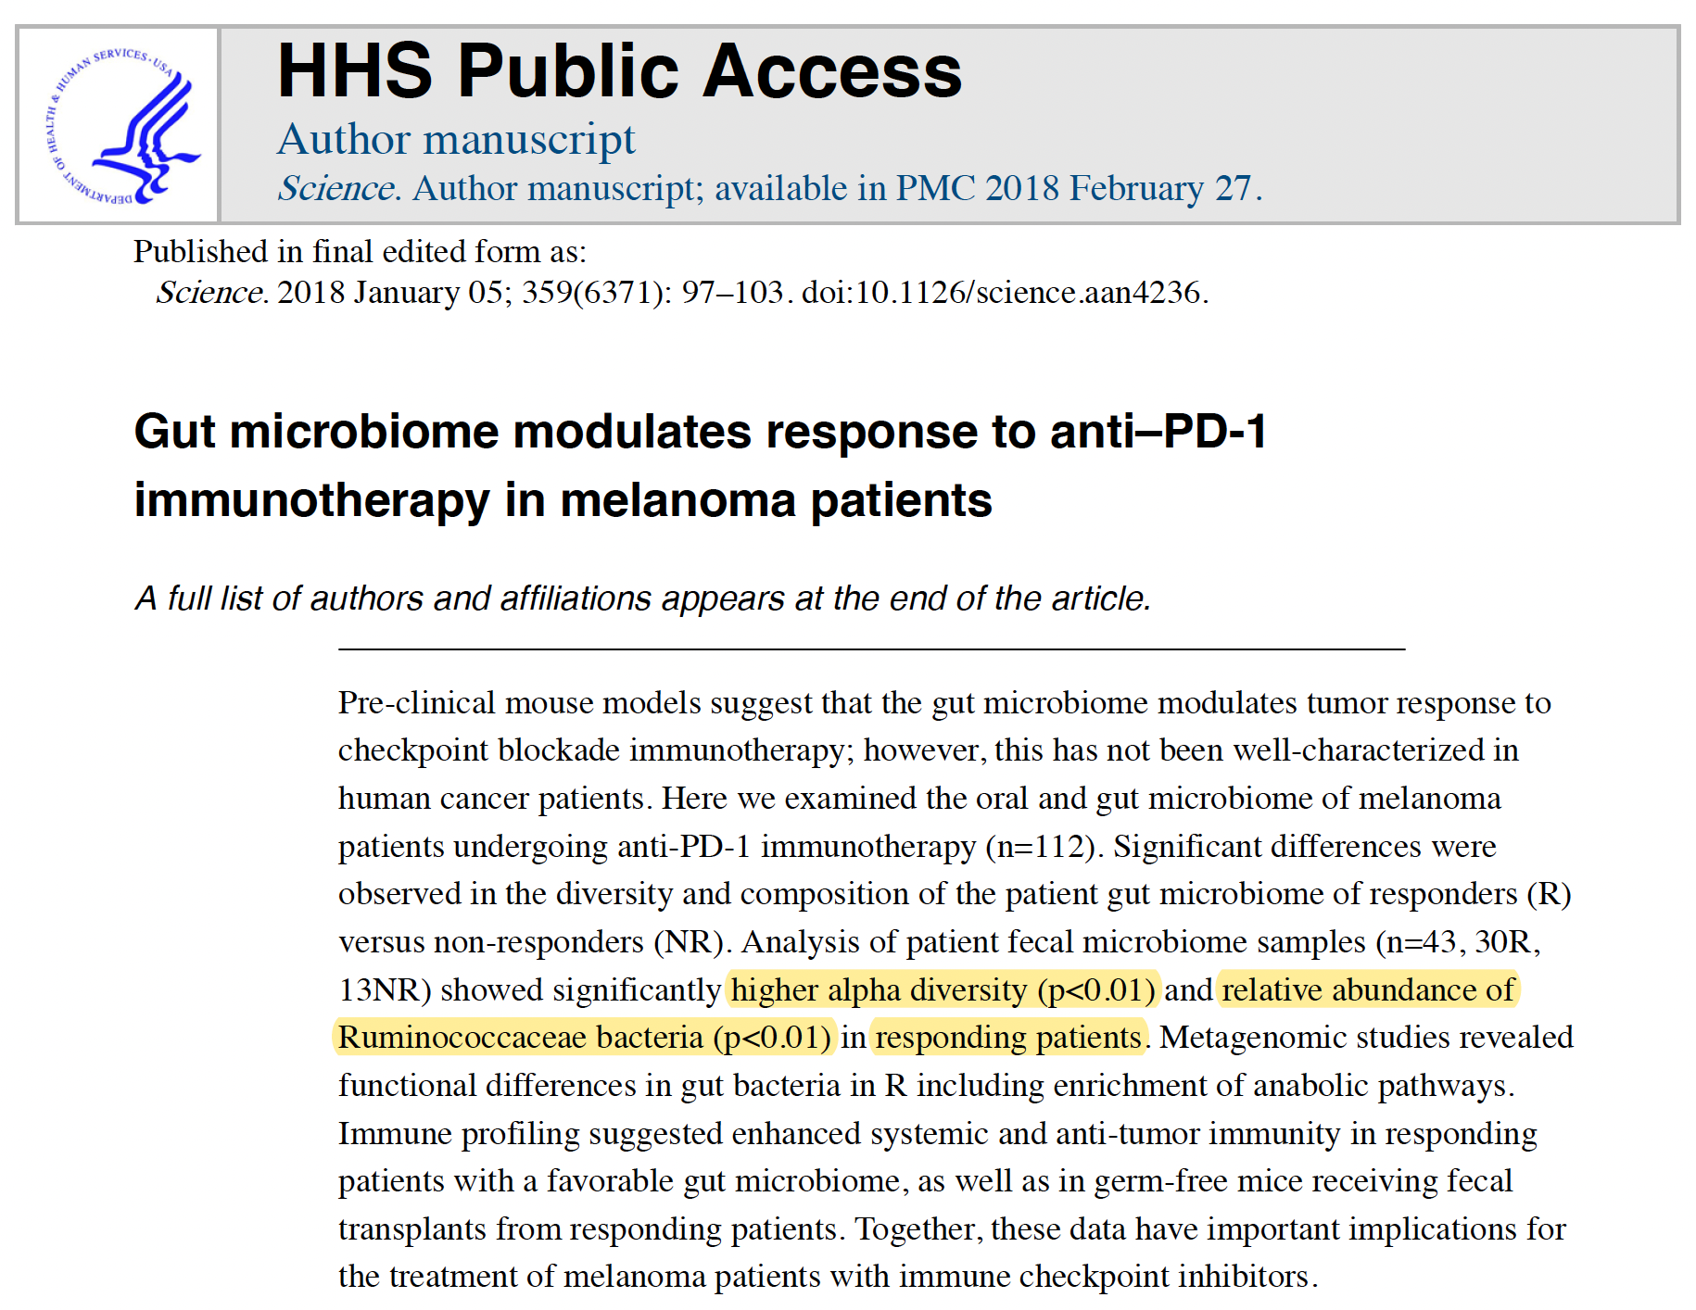

Slide 5
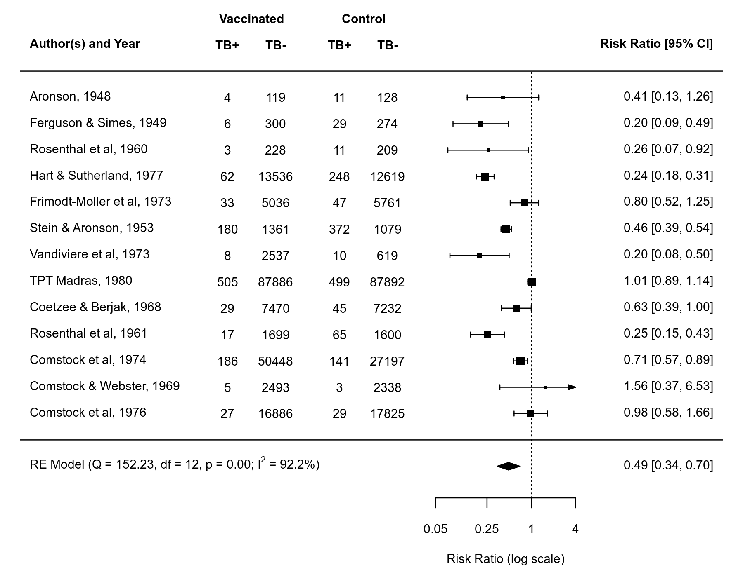
Source: https://www.metafor-project.org/doku.php/plots:forest_plot

Slide 6
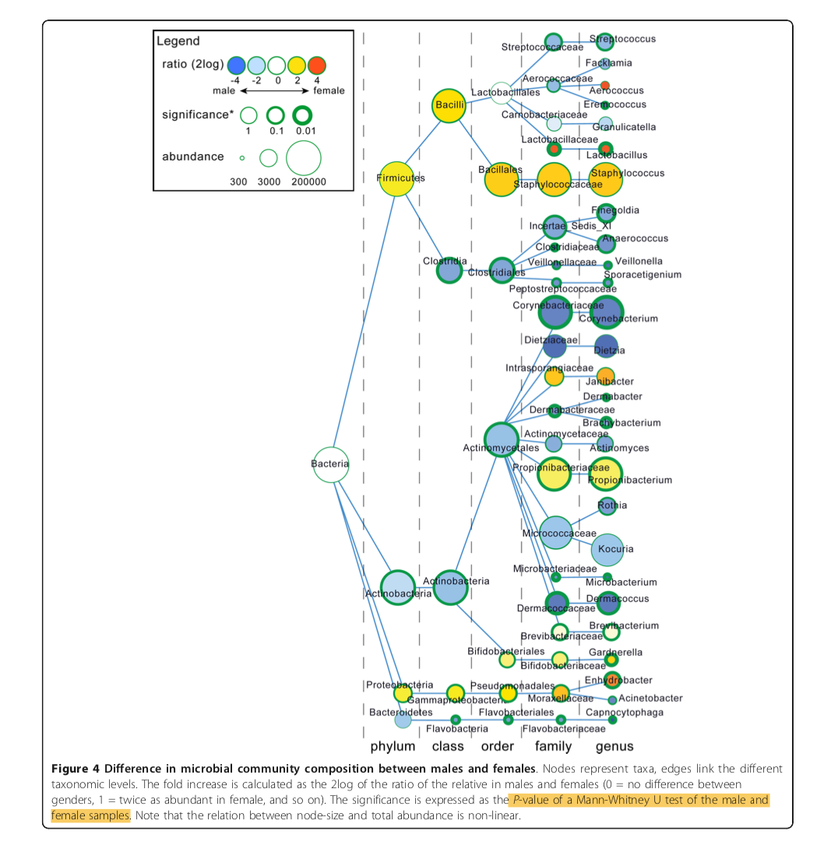
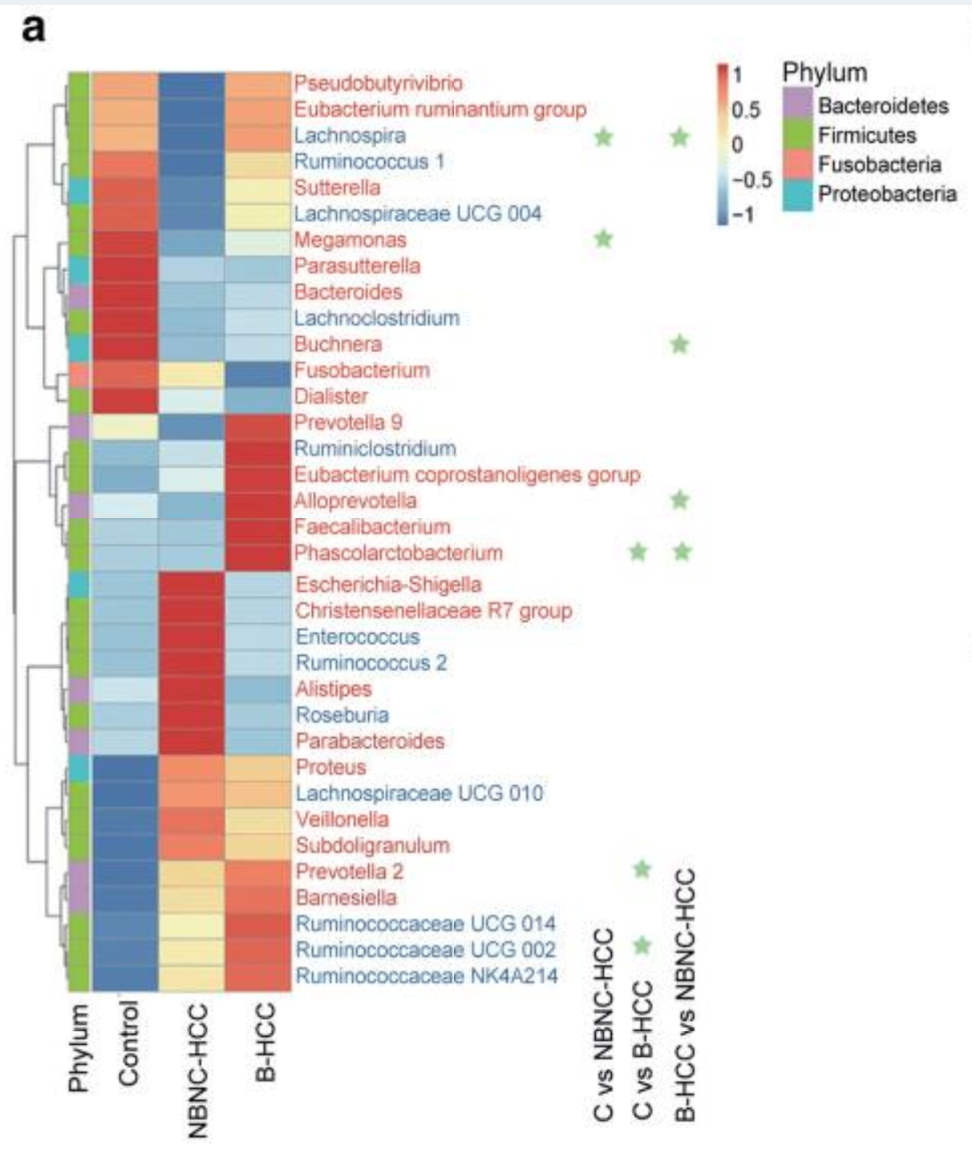
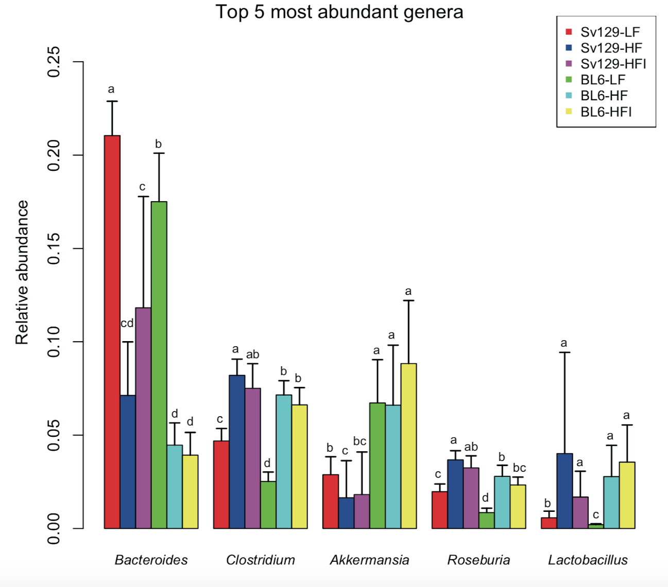
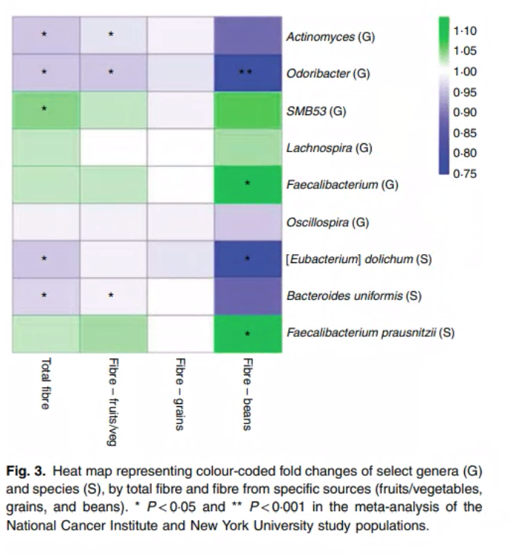
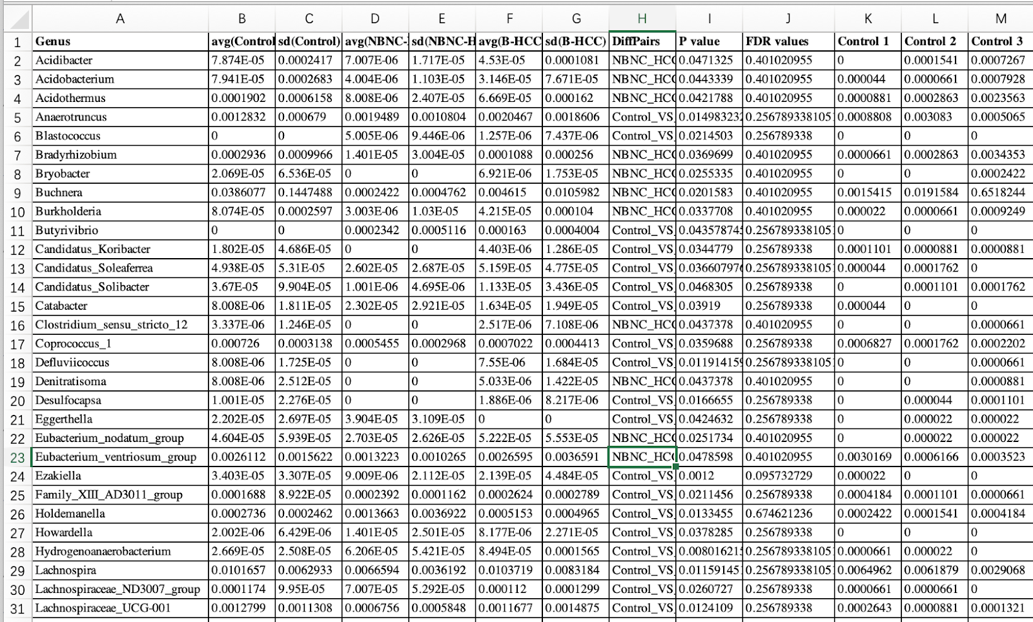
High-dimensional data

Slide 7
The need for standardized microbiome methods and results
Impossible to systematically compare results to published literature
No equivalent of GO, mSigDB, etc. available for microbiome studies
Ludwig Geistlinger
Chloe Mirzayi
Rimsha Azhar
Fatima Zohra

Slide 8
BugSigDB
A Comprehensive Database of Published Microbial Signatures
Standardizes published microbiome signatures of human health conditions and exposures in a publicly editable Semantic MediaWiki
Records information including
Study design
Bioinformatic and statistical analysis
Diversity measures
Differentially abundant taxa
Bulk data export for high-throughput analysis, e.g. EnrichmentBrowser Bioconductor package
>3,300 microbial signatures >850 published papers >90 curators
Geistlinger L et al.: BugSigDB captures patterns of differential abundance across a broad range of host-associated microbial signatures. Nat. Biotechnol. 2023.

Slide 9
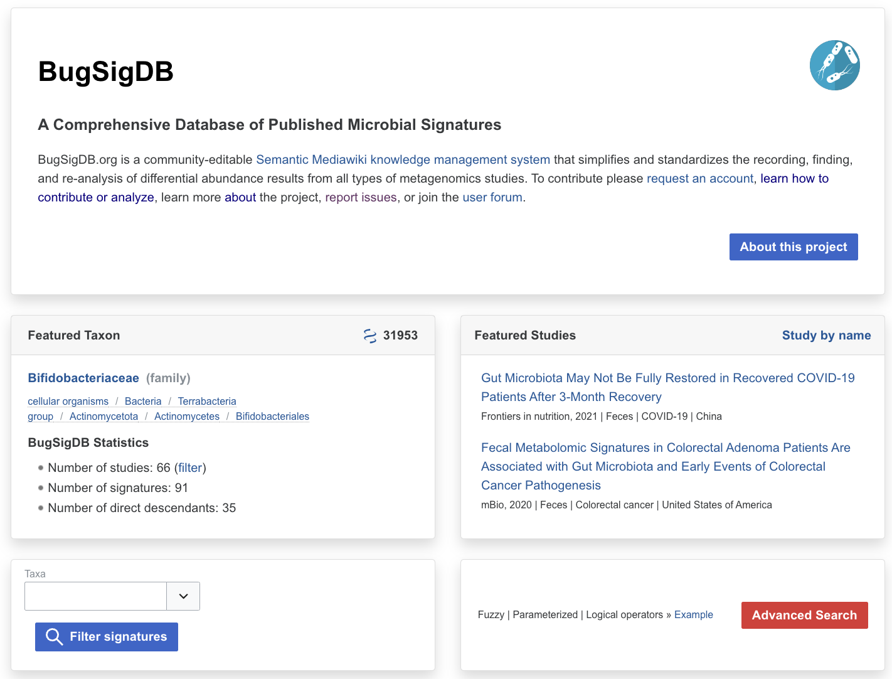
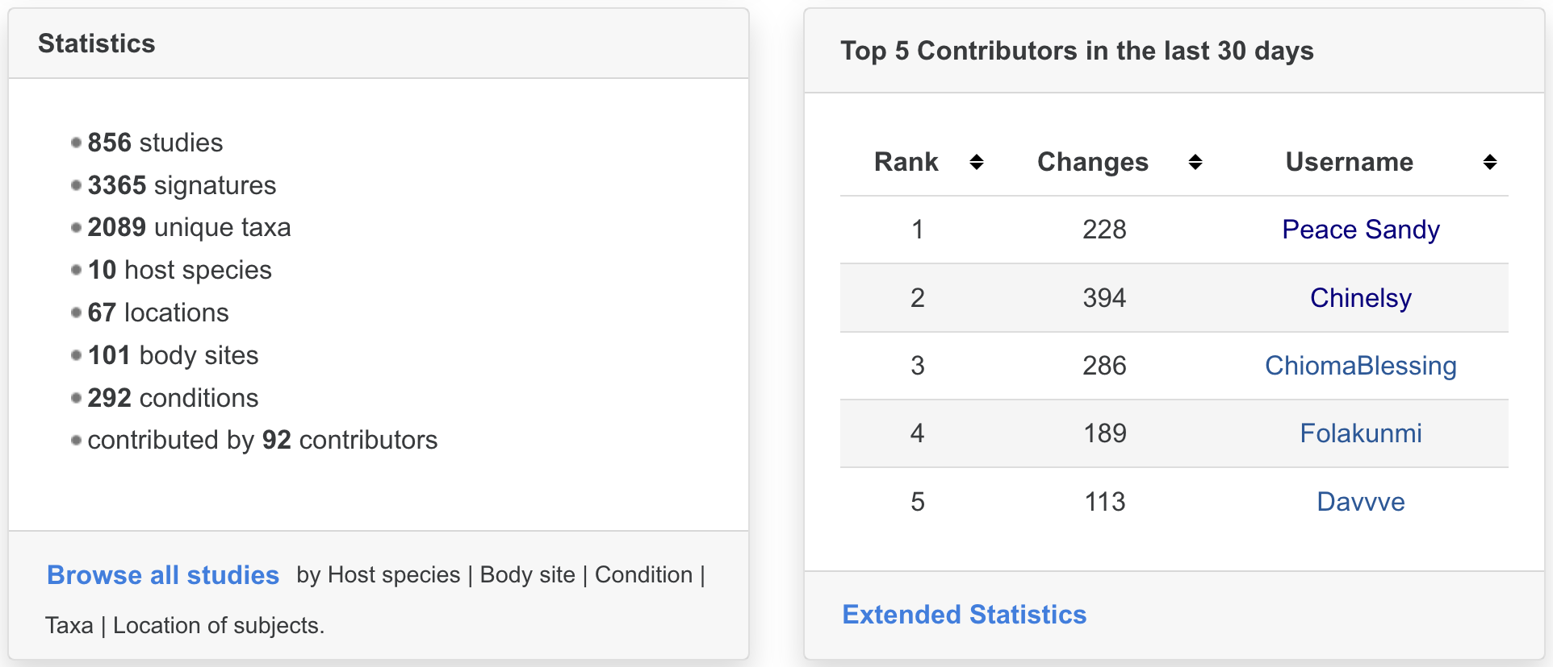

Slide 10
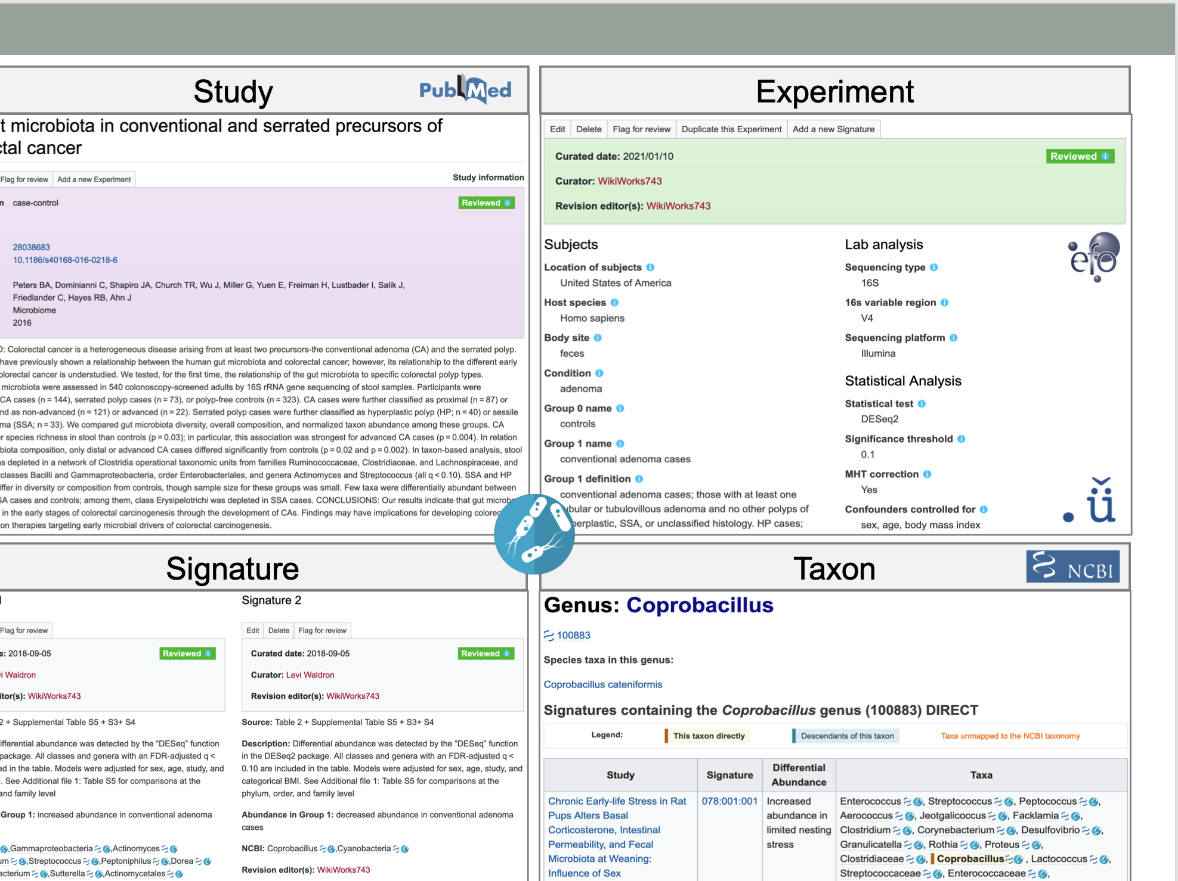
BugSigDB.org wiki pages & subpages

Slide 11
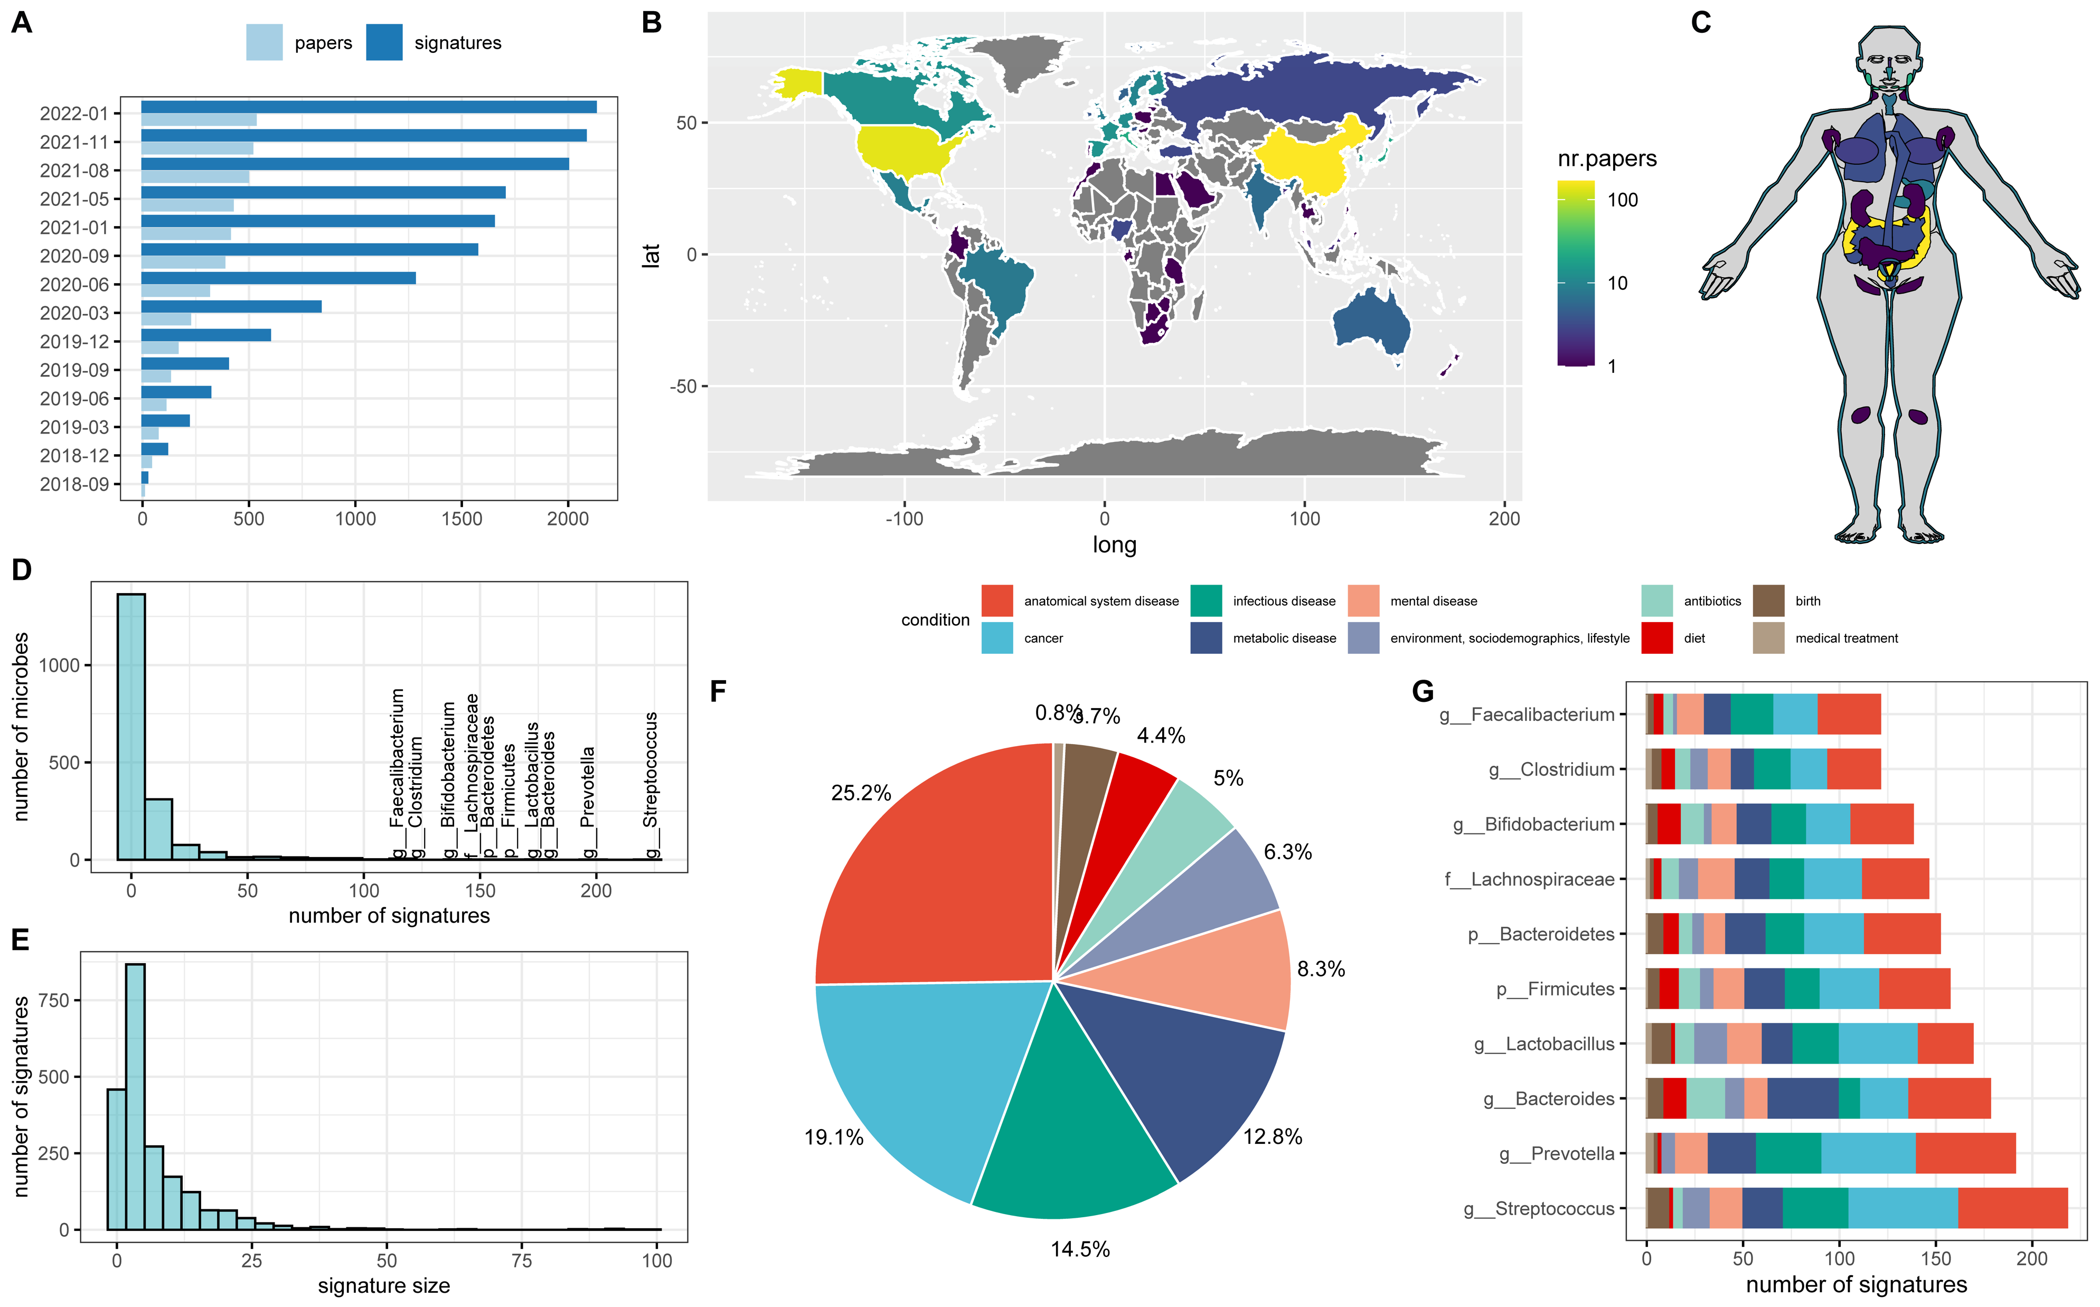

Slide 12
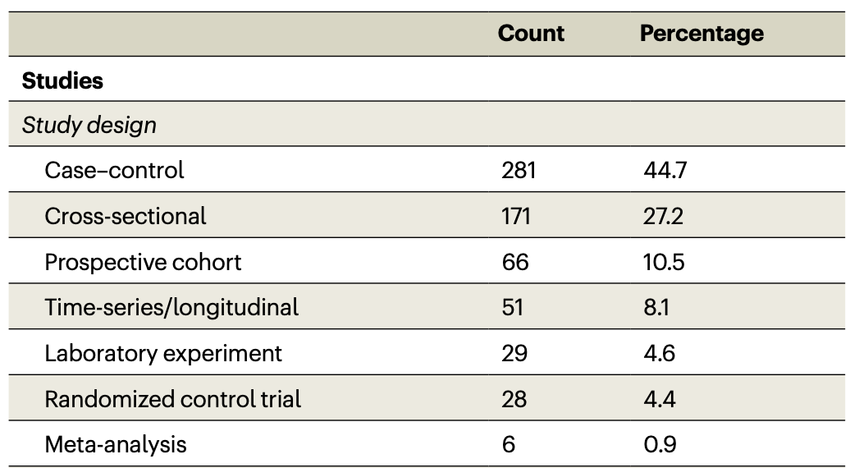
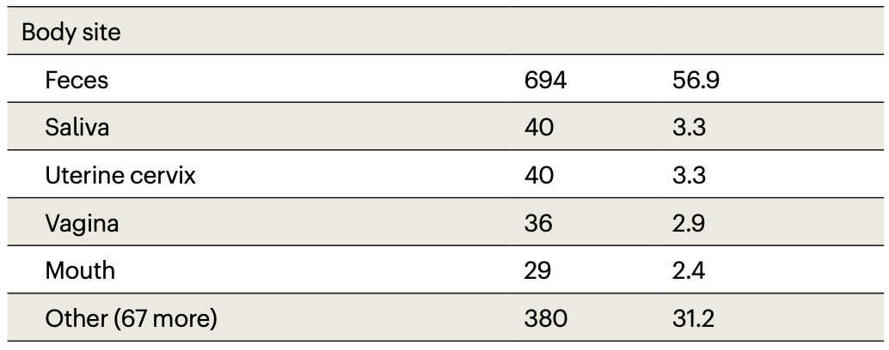
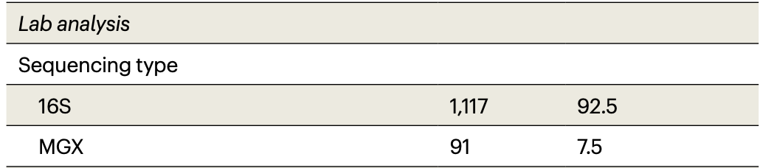
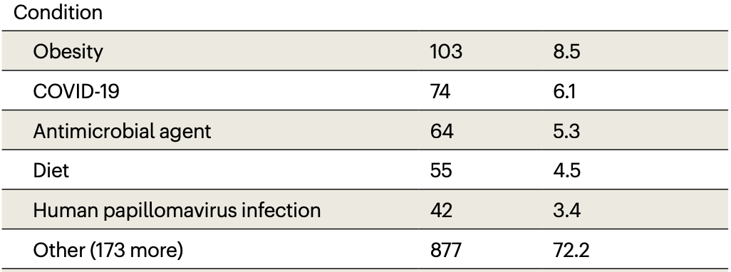

Slide 13
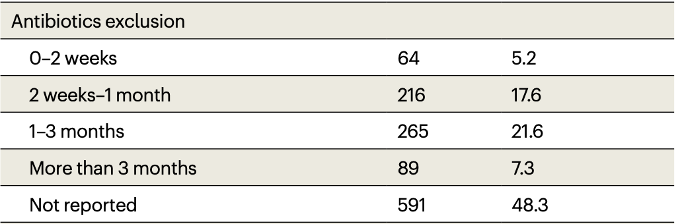

Slide 14
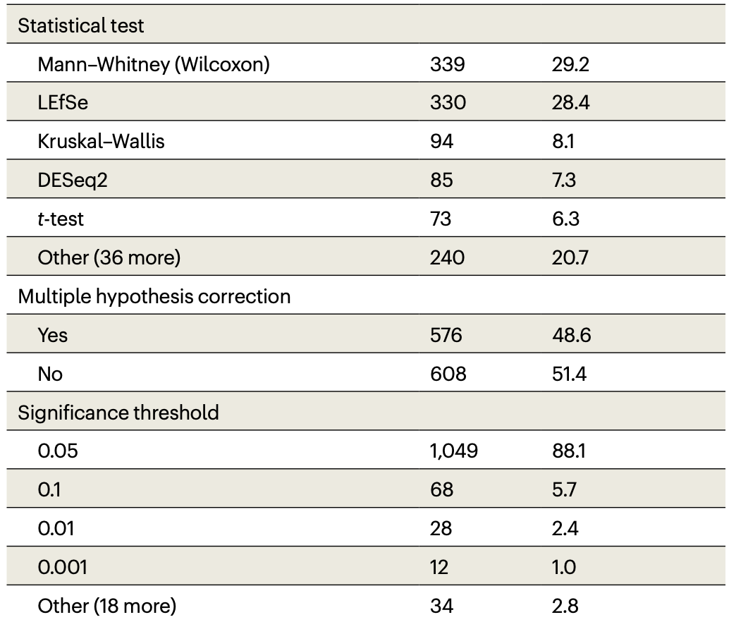

Slide 15
“Bug set enrichment analysis” (BSEA)
Meta-analysis signature as a positive control
662 colorectal cancer samples and 652 matched controls from 10 published shotgun datasets in curatedMetagenomicData
Enrichment analysis across bugsigdb.org
Over-representation analysis (ORA, Fisher’s Exact)
Pathway Analysis with Down-weighting of Overlapping Genes (PADOG)
Competitive Balances for taxonomic Enrichment Analysis (CBEA)
Notes:
Figure 3. Bug set enrichment analysis reveals established and novel associations of the human microbiome with colorectal cancer and other disease phenotypes. (A) Overrepresentation analysis (ORA) of BugSigDB signatures with differentially abundant genera between 662 colorectal cancer samples and 653 control samples pooled from 10 published metagenomic datasets. Each dot corresponds to an enriched published signature from BugSigDB (FDR < 0.05, Fisher’s exact test, color scale). The size of each dot corresponds to the number of differentially abundant genera in a signature, given as a proportion on the x-axis. * Prior meta-analytic signatures from Thomas et al., 2019⁵² and Wirbel et al., 2019⁵³ which reported differentially abundant species and genera from meta-analysis of 8 colorectal cancer datasets. These act as positive controls, as several of the datasets being tested for enrichment were included at the time these signatures were derived. (B) Differentially abundant genera (x-axis) in the top 15 enriched signatures (y-axis) from the overrepresentation analysis in (A). The x-axis is sorted by occurrence frequency of each genus in decreasing order, the y-axis is sorted by Jaccard similarity between signatures. (C) Percentile of ranks (y-axis) of both meta-analytic signatures for ORA, pathway analysis with down-weighting of overlapping genes (PADOG), and competitive balances for taxonomic enrichment analysis (CBEA) relative to all signatures when applied to the 10 published metagenomic datasets individually (x-axis). # Datasets not included as training sets in the meta-analyses of Thomas et al., 2019, and Wirbel et al., 2019. (D) Assessment of statistically significant differences of the percentile ranks shown in (C) between the three methods using Wilcoxon’s signed-rank test.

Slide 16
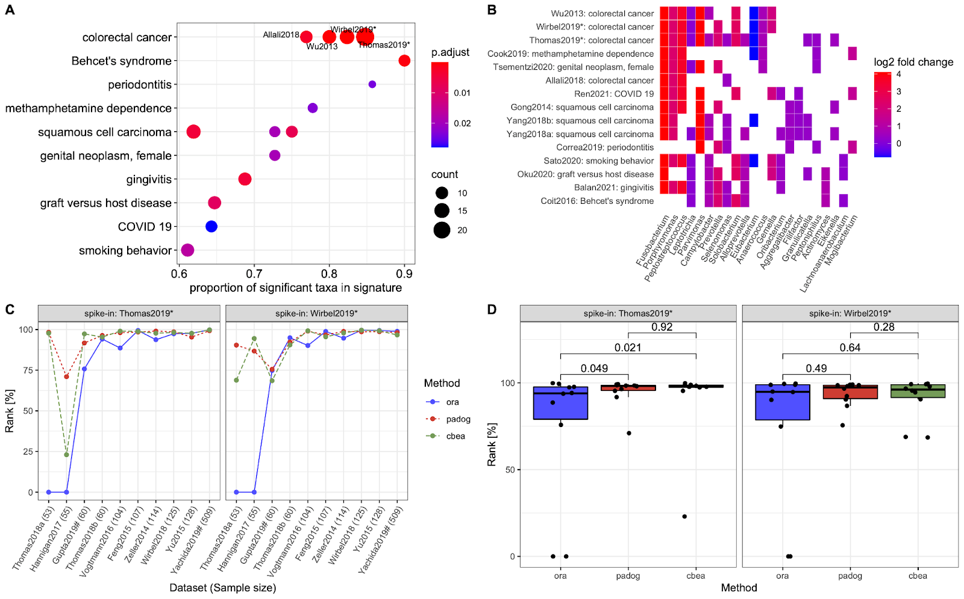
High enrichment in other CRC signatures
Even across sequencing strategies
Notes:
Figure 3. Bug set enrichment analysis reveals established and novel associations of the human microbiome with colorectal cancer and other disease phenotypes. (A) Overrepresentation analysis (ORA) of BugSigDB signatures with differentially abundant genera between 662 colorectal cancer samples and 653 control samples pooled from 10 published metagenomic datasets. Each dot corresponds to an enriched published signature from BugSigDB (FDR < 0.05, Fisher’s exact test, color scale). The size of each dot corresponds to the number of differentially abundant genera in a signature, given as a proportion on the x-axis. * Prior meta-analytic signatures from Thomas et al., 2019⁵² and Wirbel et al., 2019⁵³ which reported differentially abundant species and genera from meta-analysis of 8 colorectal cancer datasets. These act as positive controls, as several of the datasets being tested for enrichment were included at the time these signatures were derived. (B) Differentially abundant genera (x-axis) in the top 15 enriched signatures (y-axis) from the overrepresentation analysis in (A). The x-axis is sorted by occurrence frequency of each genus in decreasing order, the y-axis is sorted by Jaccard similarity between signatures. (C) Percentile of ranks (y-axis) of both meta-analytic signatures for ORA, pathway analysis with down-weighting of overlapping genes (PADOG), and competitive balances for taxonomic enrichment analysis (CBEA) relative to all signatures when applied to the 10 published metagenomic datasets individually (x-axis). # Datasets not included as training sets in the meta-analyses of Thomas et al., 2019, and Wirbel et al., 2019. (D) Assessment of statistically significant differences of the percentile ranks shown in (C) between the three methods using Wilcoxon’s signed-rank test.

Slide 17
Rank of “spike-in” positive control signatures among all signatures
All methods work
ORA sensitive to cut-offs
CBEA allows mixed taxonomic rank
Notes:
Figure 3. Bug set enrichment analysis reveals established and novel associations of the human microbiome with colorectal cancer and other disease phenotypes. (A) Overrepresentation analysis (ORA) of BugSigDB signatures with differentially abundant genera between 662 colorectal cancer samples and 653 control samples pooled from 10 published metagenomic datasets. Each dot corresponds to an enriched published signature from BugSigDB (FDR < 0.05, Fisher’s exact test, color scale). The size of each dot corresponds to the number of differentially abundant genera in a signature, given as a proportion on the x-axis. * Prior meta-analytic signatures from Thomas et al., 2019⁵² and Wirbel et al., 2019⁵³ which reported differentially abundant species and genera from meta-analysis of 8 colorectal cancer datasets. These act as positive controls, as several of the datasets being tested for enrichment were included at the time these signatures were derived. (B) Differentially abundant genera (x-axis) in the top 15 enriched signatures (y-axis) from the overrepresentation analysis in (A). The x-axis is sorted by occurrence frequency of each genus in decreasing order, the y-axis is sorted by Jaccard similarity between signatures. (C) Percentile of ranks (y-axis) of both meta-analytic signatures for ORA, pathway analysis with down-weighting of overlapping genes (PADOG), and competitive balances for taxonomic enrichment analysis (CBEA) relative to all signatures when applied to the 10 published metagenomic datasets individually (x-axis). # Datasets not included as training sets in the meta-analyses of Thomas et al., 2019, and Wirbel et al., 2019. (D) Assessment of statistically significant differences of the percentile ranks shown in (C) between the three methods using Wilcoxon’s signed-rank test.

Slide 18
Similarities with other health outcomes are real
Notes:
Figure 3. Bug set enrichment analysis reveals established and novel associations of the human microbiome with colorectal cancer and other disease phenotypes. (A) Overrepresentation analysis (ORA) of BugSigDB signatures with differentially abundant genera between 662 colorectal cancer samples and 653 control samples pooled from 10 published metagenomic datasets. Each dot corresponds to an enriched published signature from BugSigDB (FDR < 0.05, Fisher’s exact test, color scale). The size of each dot corresponds to the number of differentially abundant genera in a signature, given as a proportion on the x-axis. * Prior meta-analytic signatures from Thomas et al., 2019⁵² and Wirbel et al., 2019⁵³ which reported differentially abundant species and genera from meta-analysis of 8 colorectal cancer datasets. These act as positive controls, as several of the datasets being tested for enrichment were included at the time these signatures were derived. (B) Differentially abundant genera (x-axis) in the top 15 enriched signatures (y-axis) from the overrepresentation analysis in (A). The x-axis is sorted by occurrence frequency of each genus in decreasing order, the y-axis is sorted by Jaccard similarity between signatures. (C) Percentile of ranks (y-axis) of both meta-analytic signatures for ORA, pathway analysis with down-weighting of overlapping genes (PADOG), and competitive balances for taxonomic enrichment analysis (CBEA) relative to all signatures when applied to the 10 published metagenomic datasets individually (x-axis). # Datasets not included as training sets in the meta-analyses of Thomas et al., 2019, and Wirbel et al., 2019. (D) Assessment of statistically significant differences of the percentile ranks shown in (C) between the three methods using Wilcoxon’s signed-rank test.

Slide 19
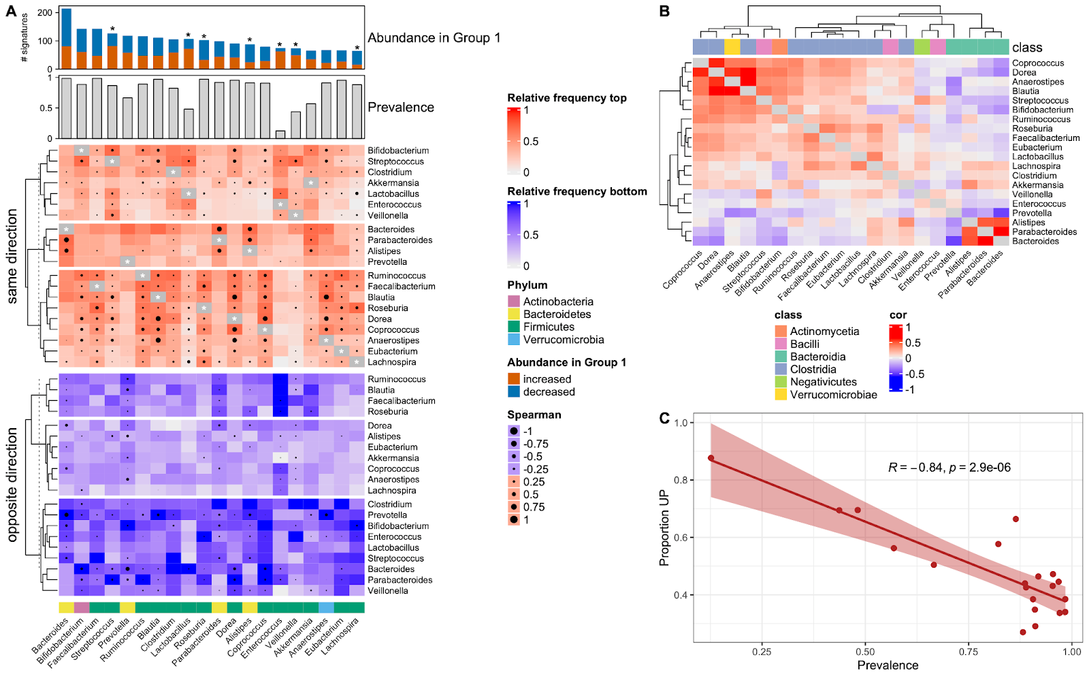
Co-occurrence Co-exclusion
Spearman correlation dots are in healthy stool samples from cMD
Some co-occurrence recapitulates patterns in healthy subjects
Enterococcus present in disease at the expense of
Ruminococcus, Blautia, Faecalibacterium, Roseburia
Notes:
Figure 4. Microbe co-occurrence and mutual exclusivity in BugSigDB reveals recurrent groups of taxa within signatures of differential abundance. (A) Microbe-microbe co-occurrence and mutual exclusivity across 1,194 signatures of fecal microbiomes from 311 published studies. “Abundance in Group 1” shows the top 20 genera most frequently reported as differentially abundant in the study group of these signatures. Stars indicate microbes which tend to be predominantly unidirectional, i.e. reported specifically with increased or decreased abundance in the study group (based on a >2-fold difference in proportions). “Prevalence” shows the prevalence of these genera in 9,623 healthy adult stool samples pooled from 68 different studies. The top heatmap shows co-occurrence between these top 20 genera, i.e. in how many signatures these microbes are reported together as differentially abundant with the same direction of abundance change (i.e. occurring together in either the UP or the DOWN signature). The bottom heatmap shows mutual exclusivity between these top 20 genera, i.e. in how many signatures these microbes are reported as differential abundant with opposite direction of abundance change (i.e. one microbe in the UP signature and the other in the DOWN signature, or vice versa). (B) Spearman correlation between the top 20 genera in healthy adult stool samples as indicated by circles of varying size in A. (C) Proportion of signatures where each of the top 20 genera was reported with increased abundance in the study group (y-axis) against the prevalence of these genera (x-axis) in healthy adult stool samples as shown in A.

Slide 20
Compartmentalization of genera by body site, disease
Which genera are:
Ubiquitous?
Common within disease or body site?
Exclusive to a condition?

Slide 21
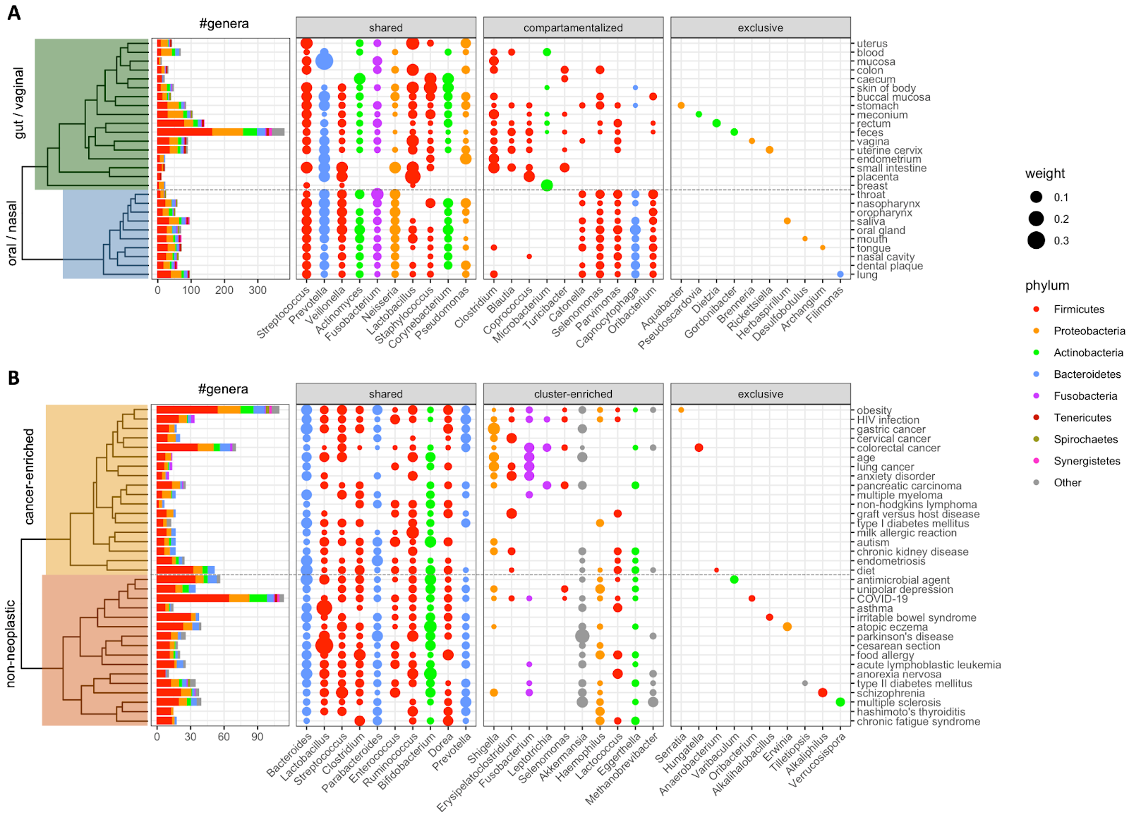
Shared, compartmentalized, exclusive genera by body site
Oral genera that transit to gut
Oral genera that do not transit to gut
Exclusive to one body site
Notes:
Figure 5. Pooled genus-level microbial signatures display robust body-site specificity and shared and exclusive patterns of gut dysbiosis between disease phenotypes. A) Clustering of 27 meta-signatures (y-axis) representing host body sites studied by at least 2 studies in BugSigDB and generated from 1,909 individual signatures. The clustering shows a separation of vaginal and gastrointestinal sites (top) from oral and nasal sites (bottom). A total of 560 different genera (x-axis) colored by phylum were observed across the meta-signatures. The number of genera in each meta-signature is shown in the barplot on the left. The following three panels display representative genera that frequently occur across meta-signatures (“shared”), predominantly occur in either cluster of body sites (“compartmentalized”), or were reported in only one body site as differentially abundant (“exclusive”). The size of each dot corresponds to the relative sample size of studies reporting a genus as differentially abundant. B) Clustering of fecal meta-signatures drawn from 34 different conditions, each represented by at least 2 studies in BugSigDB and generated from 504 individual signatures with increased abundance in the study group. The clustering shows a separation of cancer phenotypes (top) from non-neoplastic diseases (bottom). A total of 248 different genera colored by phylum were observed across the fecal meta-signatures. The number of genera in each meta-signature is shown in the barplot on the left.

Slide 22
Shared, compartmentalized, exclusive fecal genera by disease
Notes:
Figure 5. Pooled genus-level microbial signatures display robust body-site specificity and shared and exclusive patterns of gut dysbiosis between disease phenotypes. A) Clustering of 27 meta-signatures (y-axis) representing host body sites studied by at least 2 studies in BugSigDB and generated from 1,909 individual signatures. The clustering shows a separation of vaginal and gastrointestinal sites (top) from oral and nasal sites (bottom). A total of 560 different genera (x-axis) colored by phylum were observed across the meta-signatures. The number of genera in each meta-signature is shown in the barplot on the left. The following three panels display representative genera that frequently occur across meta-signatures (“shared”), predominantly occur in either cluster of body sites (“compartmentalized”), or were reported in only one body site as differentially abundant (“exclusive”). The size of each dot corresponds to the relative sample size of studies reporting a genus as differentially abundant. B) Clustering of fecal meta-signatures drawn from 34 different conditions, each represented by at least 2 studies in BugSigDB and generated from 504 individual signatures with increased abundance in the study group. The clustering shows a separation of cancer phenotypes (top) from non-neoplastic diseases (bottom). A total of 248 different genera colored by phylum were observed across the fecal meta-signatures. The number of genera in each meta-signature is shown in the barplot on the left.

Slide 23
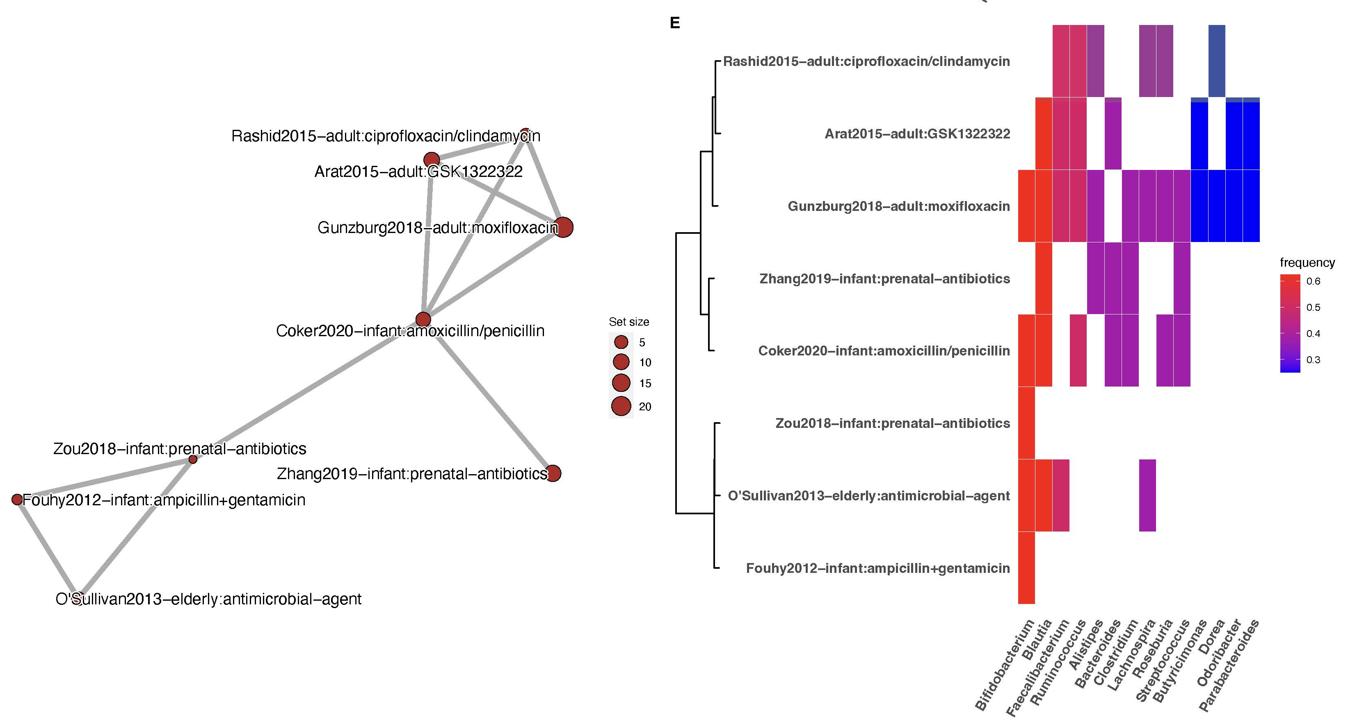
Most reproducible research topics antibiotics exposure HIV infection
Notes:
Figure 2. Analysis of signature similarity in BugSigDB identifies conditions with replicable microbiome changes across studies. (A) Signature similarity analysis for conditions with fecal samples from at least two studies. Signatures were stratified by direction of abundance change into signatures with decreased abundance (DOWN panel, left) and increased abundance (UP panel, right) in the study group. Shown is the p-value (x-axis, negative log scale) obtained from testing whether the semantic similarity of signatures for each condition (y-axis) exceeds the semantic similarity of randomly sampled signatures. The size of each dot corresponds to the number of studies investigating a condition. (B-E) Example exploration of two top ranked conditions in more detail: signatures of decreased abundance for patients with HIV infection (B,C), and signatures of decreased abundance for patients treated with antibiotics (D,E). (B,D) Semantic similarity between signatures. Each node corresponds to a signature. The size of each node is proportional to the number of taxa in a signature. More similar signatures are connected by shorter and thicker edges. (C,E) Microbial contents of the signatures shown in panels B and D (y-axis) delineating the genera contained in these signatures (x-axis). Signatures are clustered by semantic similarity and the relative frequency of each genus across signatures is indicated by a color scale. Display of contained taxa is restricted to genera occurring in at least two signatures (full signatures are shown in Supplementary Figure S5 and S6).

Slide 24
Summary
Available as csv files from bugsigdb.org or through bugsigdbr Bioconductor package
Synthesize results from hundreds of studies
More than possible by re-analysis of raw data
Even if individual patient data were never shared
Helps interpret results of microbiome studies
Through enrichment analysis
Through identification of common signatures
Can identify plagiarism

Slide 25
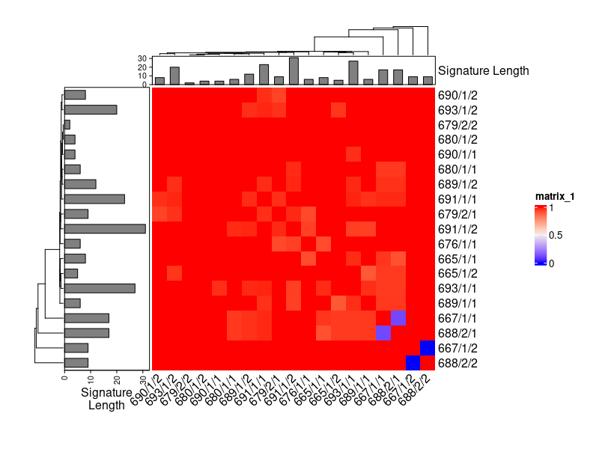
Gopalakrishnan, V. et al. Gut microbiome modulates response to anti-PD-1 immunotherapy in melanoma patients. Science 359, 97–103 (2018)
Li, L. & Ye, J. Characterization of gut microbiota in patients with primary hepatocellular carcinoma received immune checkpoint inhibitors: A Chinese population-based study. Medicine 99, e21788 (2020)
Notes:
Jaccard dissimilarity of signatures from independent studies of the gut microbiome and response to immune checkpoint inhibitors

Slide 26
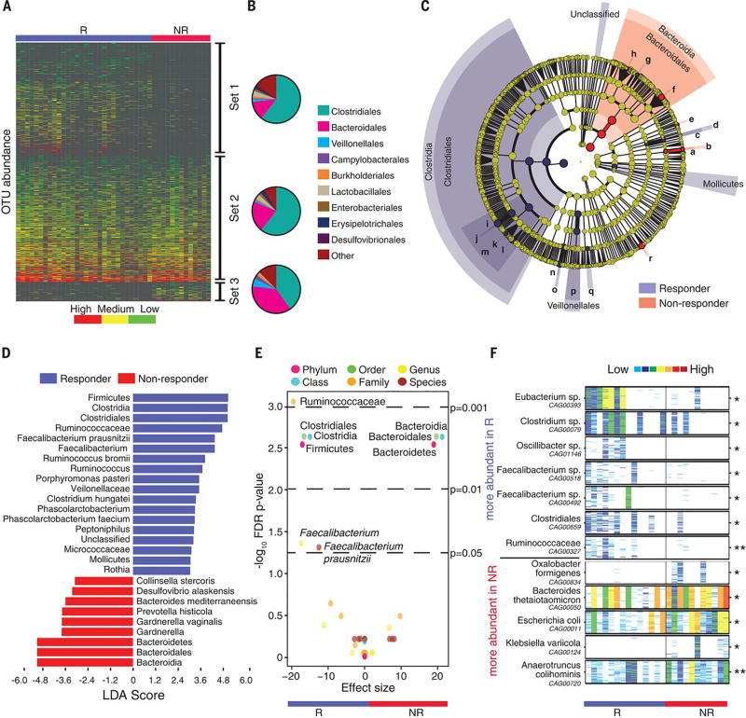
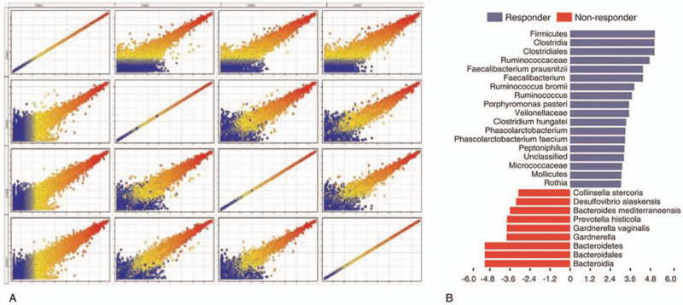
2018
2020

Slide 27
Call to action
Data availability is the beginning, not the end
Scientific papers are written for humans
we need to include machines more actively
how can machines help in writing papers?
Requirements
machine-readable formats for key methods and results
friendly for authors to use, readers to view, data scientists to parse in high throughput

Slide 28




STORMS checklist objectives
Strengthening the Organization and Reporting of Microbiome Studies
Intuitive and straightforward
Help authors write well-organized microbiome papers
Easier comparison of study designs and results between papers
Method, database, and analysis-agnostic
Mirzayi, C. et al. Reporting guidelines for human microbiome research: the STORMS checklist. Nat. Med. 27, 1885–1892 (2021)
Chloe Mirzayi, MPH
www.stormsmicrobiome.org

Slide 29
The Checklist
Number | Item | Recommendation | Source | Additional Guidance | Yes/No/NA | Comments
4.0 | Laboratory methods | State the laboratory/center where laboratory work was done. | STORMS | (not shown)
4.1 | Specimen collection | State the body site sampled from and how specimens were collected. | STORMS
4.2 | Shipping | Describe how samples were stored and shipped to the laboratory | STORMS
4.3 | Storage | Describe how the laboratory stored samples, including time between collection and storage and any preservation buffers or refridgeration used. | STORMS
4.4 | DNA extraction | Provide DNA extraction method, including kit and version if relevant | STORMS
4.5 | Human DNA removal | Describe whether human DNA removal was performed | STORMS
4.6 | Primer selection | Provide primer selection and DNA amplification methods as well as variable region sequenced (if applicable). | STORMS
4.7 | Contaminant analysis | Provide any methods used to control for or identify microbiome contamination. | STORMS
4.8 | Controls | Describe any positive and negative controls, including their source and which steps were performed on them. | STORMS
17 items (52 subitems)
divided into 6 sections:
Abstract, Introduction, Methods, Results, Discussion, Other Information
Forms the outline of a paper
Mirzayi, C. et al. Reporting guidelines for human microbiome research: the STORMS checklist. Nat. Med. 27, 1885–1892 (2021)
www.stormsmicrobiome.org

Slide 30

STORMS analytic sample size flowcharts (item 3.6)
Observational
Experimental
Expressions of interest n=xx
Expressions of interest n=xx
Assessment for eligibility:
xxxx n=xx
Assessment for eligibility:
xxxx n=xx
Screened n=xx
Screened n=xx
Excluded:
xxxx n=xx
Excluded:
xxxx n=xx
Recruited n=xx
Recruited and randomised n=xx
Drop out:
xxxx n=xx
n=xx Group 1
n=xx Group 2
Data available for analyses n=xx
Drop out:
xxxx n=xx
Excluded:
Lack of sequencing n=xx
Low number of reads n=xx
Completed trial n=xx
Total samples included in the analyses n=xx
Excluded:
Lack of sequencing n=xx
Low number of reads n=xx
Total samples included in the analyses n=xx
Public domain under CC0
www.stormsmicrobiome.org

Slide 31
Questions
Should we apply BugSigDB-like approaches more widely?
What other analyses are possible with semantic representation of the literature?

Slide 32
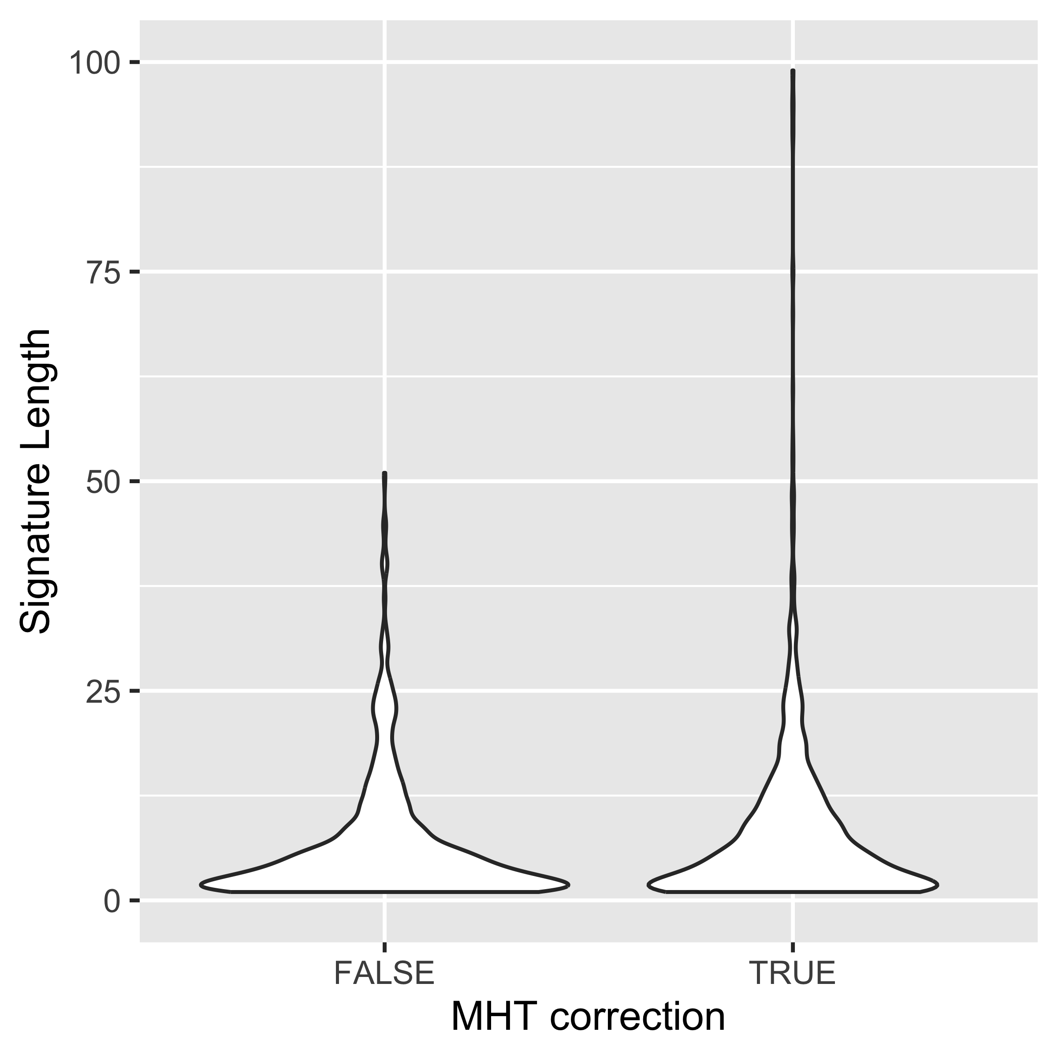
Are signatures controlled for multiple hypothesis testing larger or smaller than those without?
Notes:
library(purrr)
bsdb$length <- bsdb |>
pull(`NCBI Taxonomy IDs`) |>
map_int(length)
# Now make a violin plot
png("length_vs_mht.png", width = 4, height = 4, units = "in", res = 600)
filter(bsdb, !is.na(`MHT correction`)) |>
ggplot(aes(x = `MHT correction`, y = length)) +
geom_violin() +
scale_y_continuous(limits = c(0, 100)) +
labs(x = "MHT correction",
y = "Signature Length")
dev.off()

Slide 33
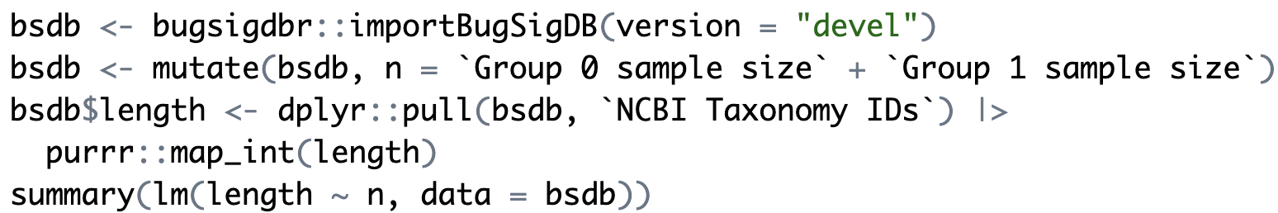
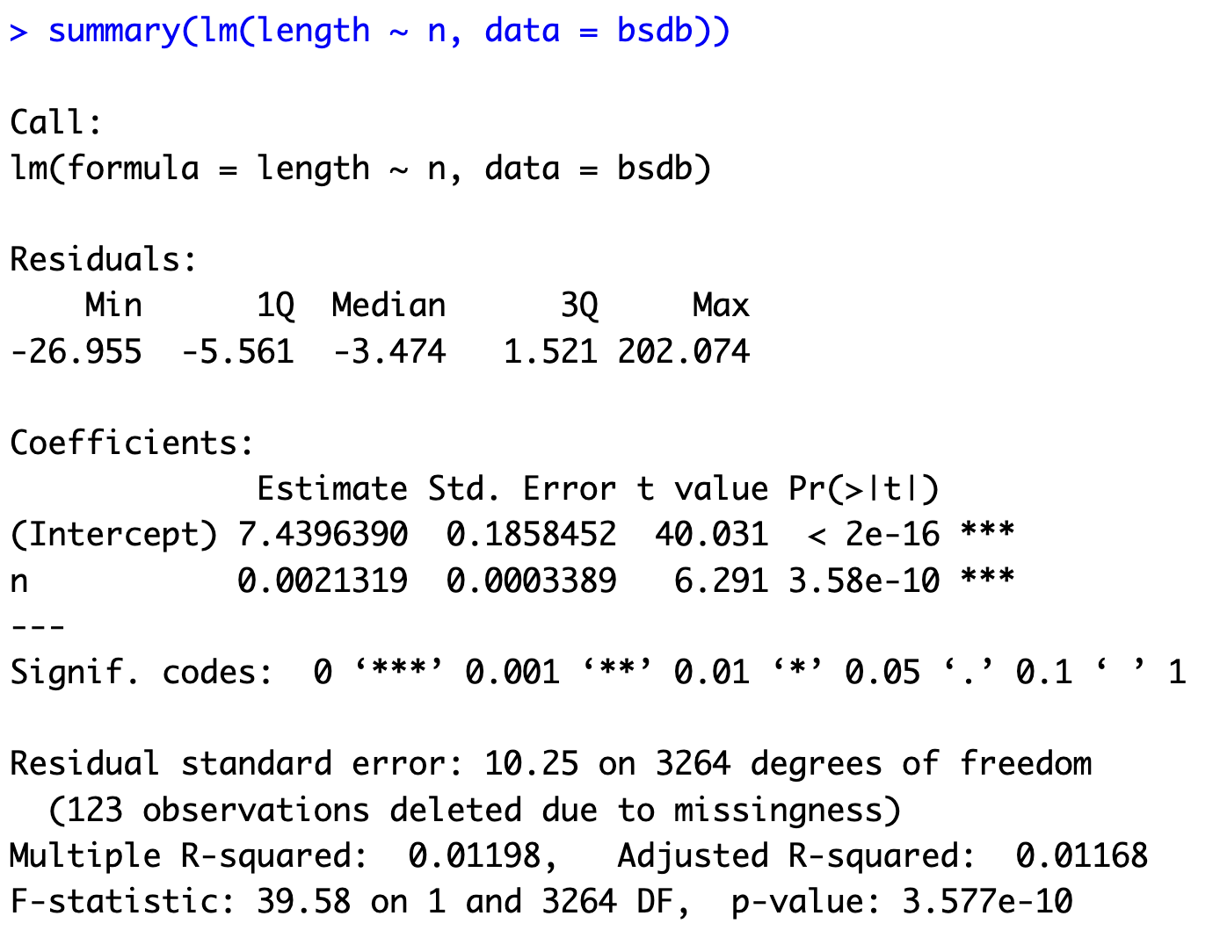
Signature length vs sample size

Slide 34
Analyst-friendly data in Bioconductor
curatedOvarianData
30 datasets, most annotated for OS, surgical debulking, histology
curatedCRCData
34 datasets, many annotated for MSS, gender, stage, age, N, M
curatedBladderData
12 datasets, many annotated for stage, grade, OS
curatedTCGAData + TCGAutils
The Cancer Genome Atlas as MultiAssayExperiment
cBioPortalData
150+ multi’omics cancer datasets as MultiAssayExperiment
HMP16SData
Simple access to The Human Microbiome Project
curatedMetagenomicData
~20K samples processed through bioBakery 3 with curated metadata
SingleCellMultiModal
Landmark datasets from new single-cell multimodal technologies
MicrobiomeBenchmarkData
Microbiome benchmarking with experimental ground truth

Slide 35

A recurring bite-sized online alternative to multi-day microbiome conferences
regular short-format (~3 hours) conferences that provide all the key elements of a traditional conference
https://www.microbiome-vif.org

